Slide 1
Online Retail Customer Segmentation
T. Sai Harish Sarma

Slide 2
Contents
Problem Statement
Data Description
Data Cleaning
Data Analysis
Feature Engineering
Preprocessing
Modelling
Conclusion

Slide 3
Problem Statement
In this Project, Our task is to identify major segments on a transnational data set which contains the transactions occurring between 01/12/2010 and 09/12/2011 for a UK based and registered non-store online retail. The company mainly sells unique all- occasion gifts. Many customers of the company are wholesalers.

Slide 4
Business Context
Businesses are growing rapidly and serving many customers. So, It is very important to categorize their customers to understand the customer and Business behavior. It also helps in marketing and Business development.

Slide 5
Data Description
Invoice No: Invoice Number ( Some Invoice No's are with letter 'C', means cancelled Transaction)(Numeric)
Stock Code: Stock Name Code
Description: Description of the product (Numeric)
Quantity: Quantity bought (Numeric)
Invoice Date: Invoice Date (Date Time)
Unit Price: Price per Unit (Numeric)
Customer ID: Unique Customer ID (Numeric)
Country: Location

Slide 6
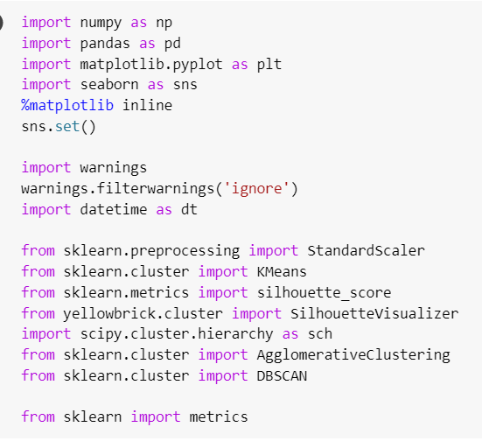
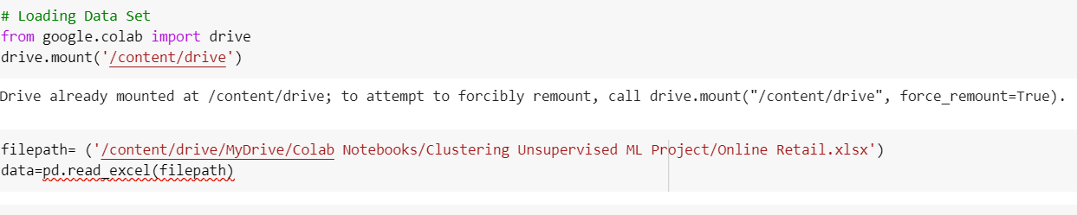
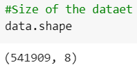
Data Description

Slide 7
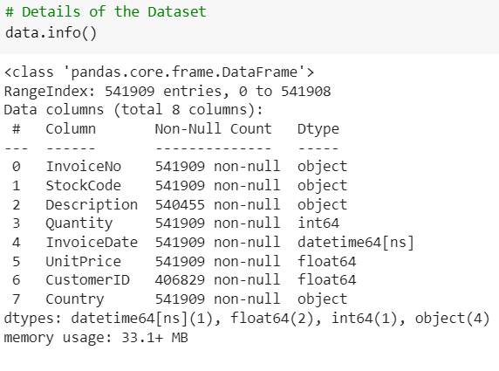
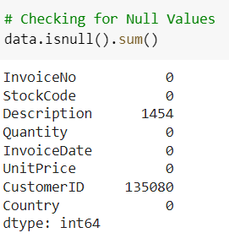
Data Description

Slide 8
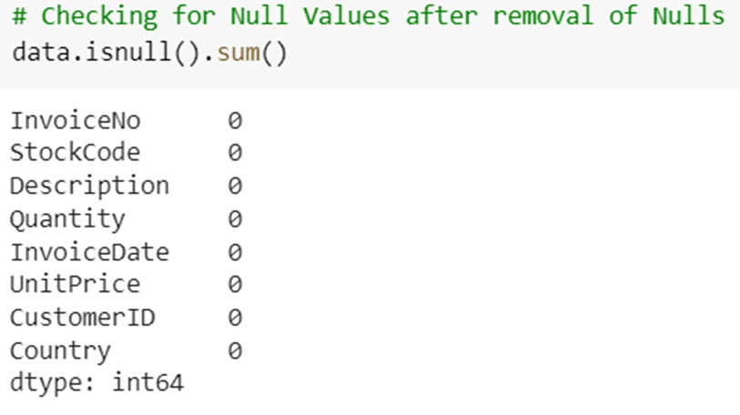
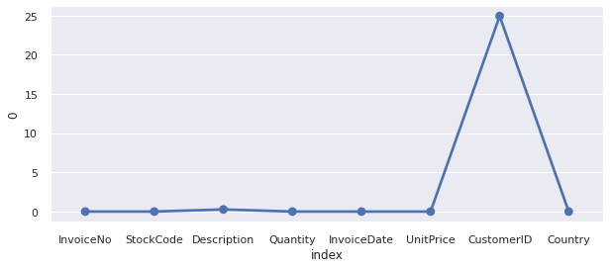
Data Cleaning
Handling Missing Values:
Customer ID is having 24.92% of missing values.
Description is having 0.26% of missing values.

Slide 9
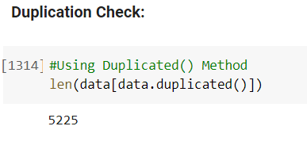
Data Cleaning
We have 5225 duplicate/ repeated entries.
We can drop them from the dataset.
We have few cancelled Invoice Nos indicated with C. We can remove them.
There are 8872 cancelled Invoices.

Slide 10
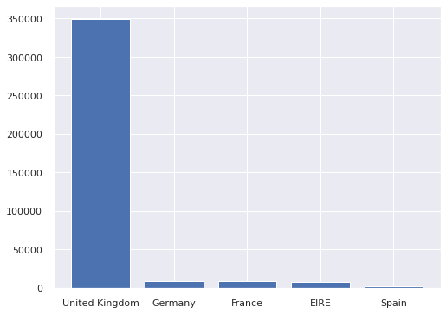
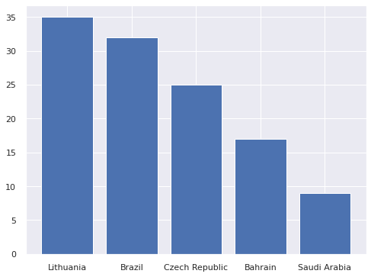
Data Analysis
Country:

Slide 11
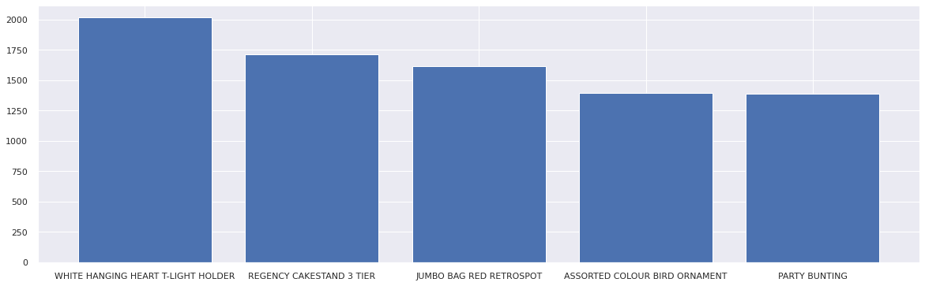
Data Analysis
Description:
There are 3877 Unique Descriptions available in Dataset.

Slide 12
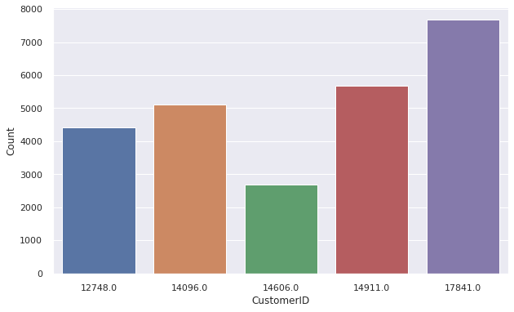
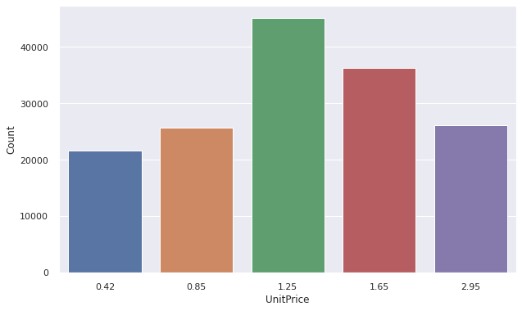
Data Analysis
Customer ID : 17841 is top most customer by having large count in No. of Purchase.
The Products having price of 1.25 dollars are the selling products.

Slide 13
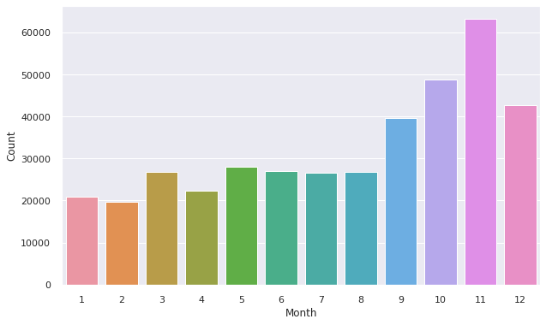
Data Analysis

Slide 14
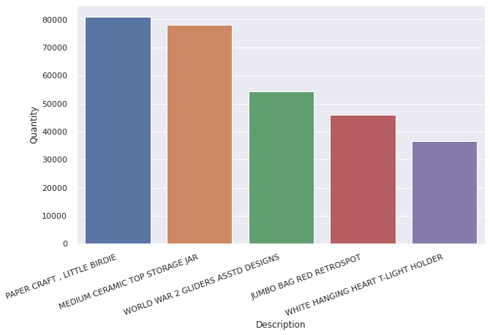
Data Analysis
The product having description as "PAPER CRAFT , LITTLE BIRDIE" is the most selling product in store.

Slide 15
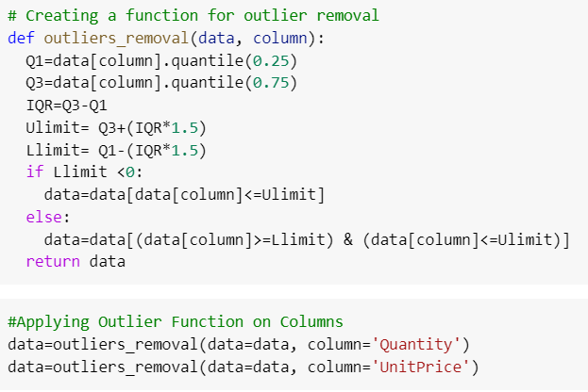
Feature Engineering

Slide 16
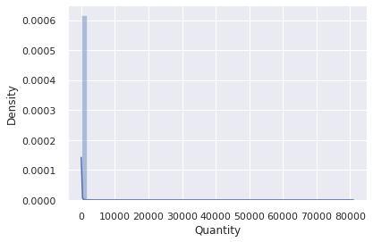
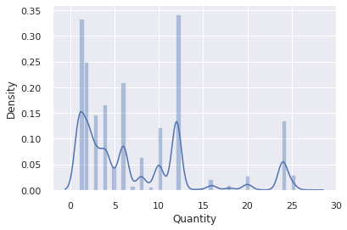
Feature Engineering

Slide 17
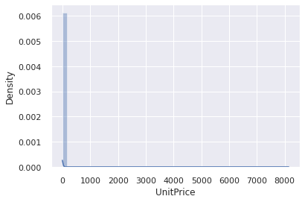
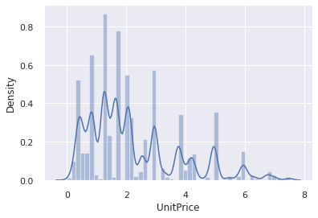
Feature Engineering

Slide 18
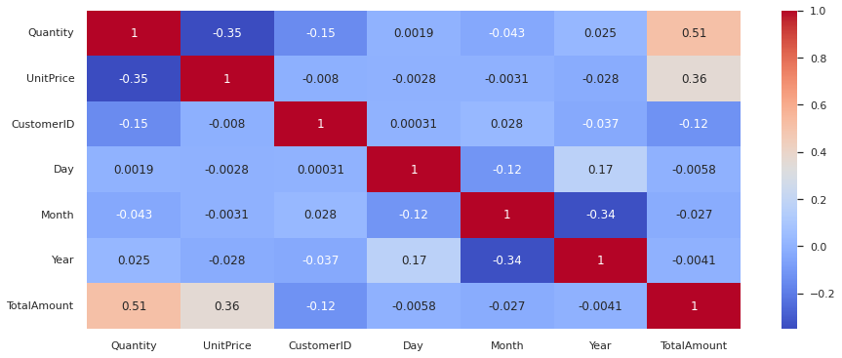
Feature Engineering

Slide 19
RFM Analysis
RFM - Recency, Frequency and Monetory is a Marketing Analysis tool used for customer segmentation.
Recency: How recently user bought/ visited.
Frequency: How regularly user purchase/ visits.
Monetory: How much revenue generated by that user.
A the part of our project, we make a Data frame by extracting above features and use them for Clustering.

Slide 20
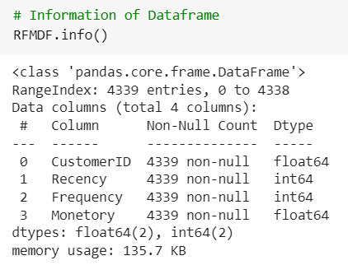
RFM Analysis

Slide 21
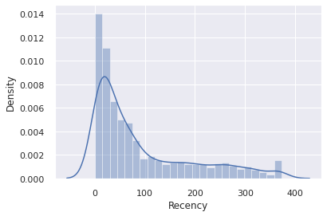
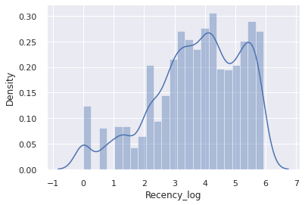
RFM Analysis
Log transformation:

Slide 22
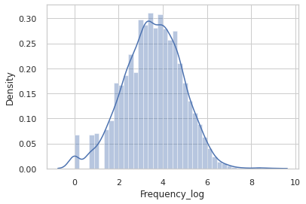
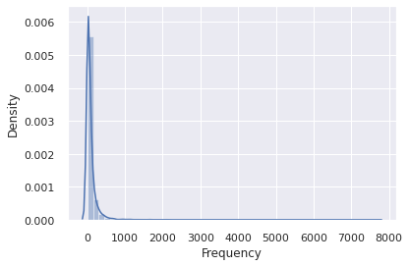
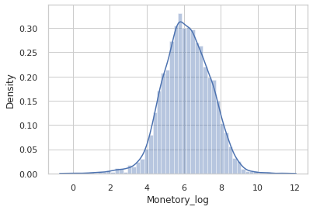
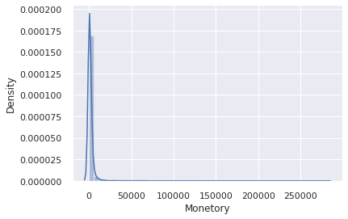
RFM Analysis
Log transformation:

Slide 23

Preprocessing

Slide 24
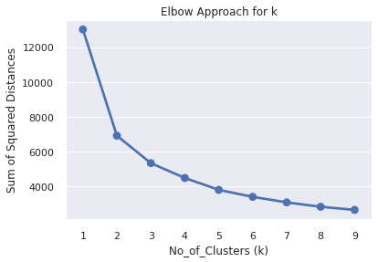
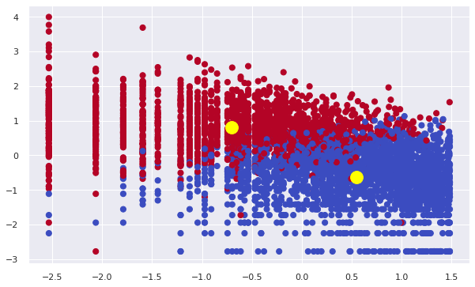
Modelling – KMeans & Elbow Curve

Slide 25
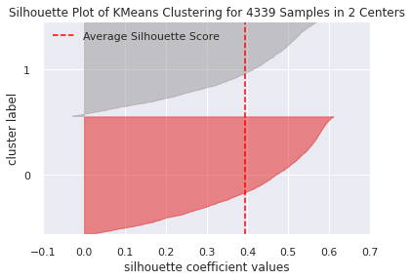

Modelling – KMeans & Silhouette Analysis

Slide 26
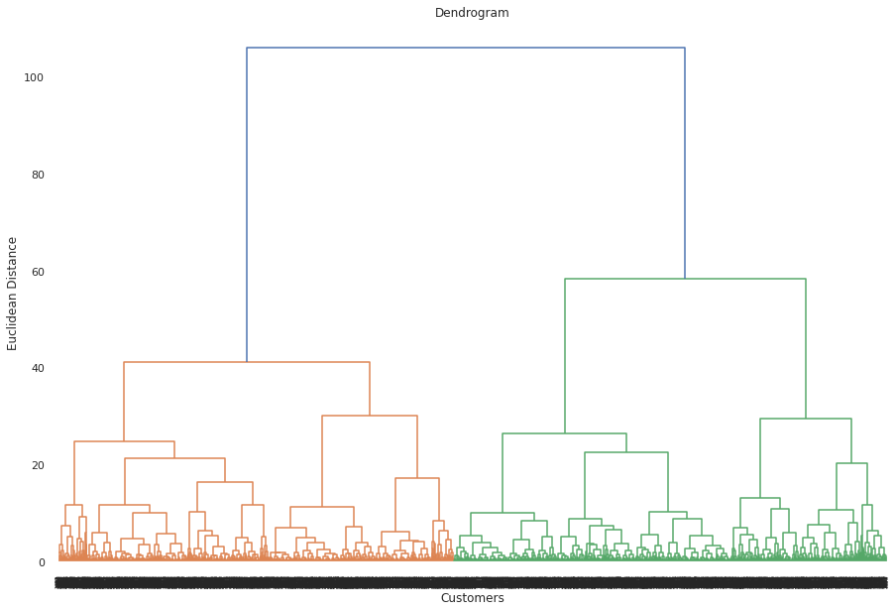
Modelling - Dendrogram

Slide 27
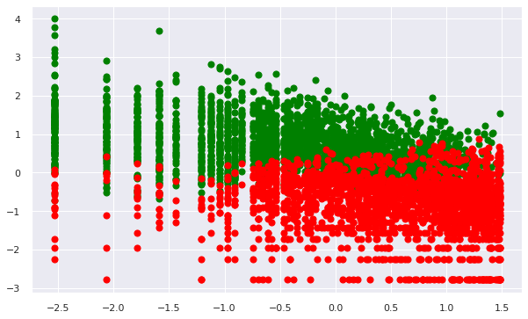
Modeling – Hierarchal Clustering

Slide 28
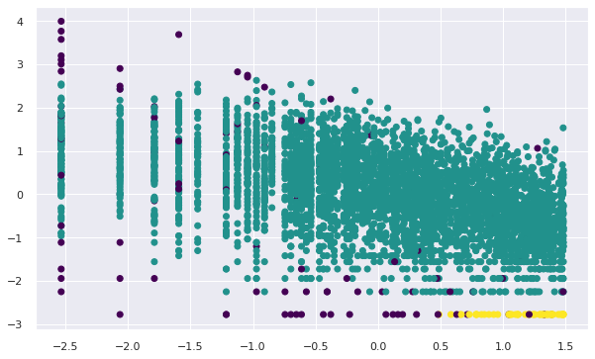
Modeling – DB SCAN

Slide 29
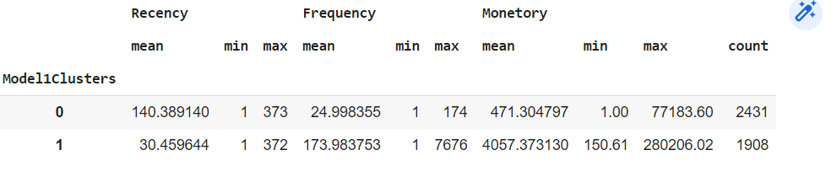
Clusters

Slide 30
Conclusion
A. EDA Outcomes:
The retail store has a large share in local region i.e., UK.
The store has least market share in Saudi Arabia.
There are 3877 Unique Descriptions available in Dataset.
Customer ID : 17841 is top most customer by having large count in No. of Purchaces.
Customer with ID 14646 is the buyer of large quantity of the store.
The product having description as "PAPER CRAFT , LITTLE BIRDIE" is the most selling preoduct in store.
B. Challenges:
1. Missing Values - Description & CustomerID are having 0.26% & 24.92% of missing values respectively.
2. Duplicated Data - 5225 in count.
3. Outliers - Quantity & Unit Price Columns.

Slide 31
Conclusion:
C. Modelling Summary:
1. We can observe that the TWO clusters are clearly formed using KMeans- Elbow Approach.
2. We can observe that the TWO clusters are clearly defined using KMeans- Silhouette Analysis Approach.
3. The TWO clusters are clearly separated using Hierarchal clustering using Dendrogram Approach.
4. The clusters are clearly separated using DB SCAN clustering. DB Scan also creates few noise data points on clustering, which can exempted. Hence, the no. of optimal clusters can be 2.
5. Model1 i.e., KMeans with Elbow Approach having highest Score, Hence, we can conclude that it works better for clustering on this data.
6. Finally, We formed TWO Clusters:
Cluster 1 - Low Recency, High Frequency and High Monetory Values
Cluster 2 - High Recency, Low Frequency and Low Monetory Values

Slide 32
Thankyou

